Slide 1
Planning
Dr. Sandip Mandal

Slide 2
Planning
Nature & Importance
Planning is actually selecting missions and objectives as well as the actions to achieve them which requires decision making. A manager’s most essential task is to see that each and every employee understands the group’s mission and objectives and the methods for attaining them. If a group effort is to be effective, people must know what they are expected to accomplish. And this is the function of planning. Planning bridges the gap from where we are to where we want to go.

Slide 3
Types of Plans
Missions or Purposes:
It identifies the basic purpose or function or tasks of an enterprise or agency or any part of it. E.g. Business - Production and distribution of products and services. State Highway Dept. – Design, Building and operation of a system of state highways. Court – Interpretation of laws and their application. University – Teaching, research and providing services to the community. In 1960s the mission of NASA, National Aeronautics Space Administration was to get a person to the moon before Russians.

Slide 4
Types of Plans
Objectives or Goals: They are the ends towards which an activity is aimed. It represents the end points of organizing, staffing, leading and controlling
Strategies : It is the determination of the basic long term objectives of an enterprise and the adoption of courses of action and allocation of resources necessary to achieve these goal

Slide 5
Types of Plans
Policies: They are the general statements or understandings that guide in decision making. Policies define an area within which a decision is to be made and ensure that the decision will be consistent with and contribute to an objective. Policies help decide issues before they become problems; make it unnecessary to analyse the same situation every time it comes up, unify other plans thus permitting managers to delegate authority and still maintain control over what their subordinates

Slide 6
Types of Plans
Procedures: They are plans that establish a required method of handling future activities. It is a chronological sequence of required actions. Procedures are guides to actions, rather than to thinking. E.g. Appraisal process of Western University
Step 1. Setting performance objectives
Step 2. Performing mid-year review of the objectives
Step 3. Conducting performance discussion at the end of the period.
E.g. Company policy – Grant employees vacations Company procedure – provide for scheduling vacations to avoid disruption of work, setting rates of vacation pay...etc.

Slide 7
Types of Plans
Rules: They spell out specific required actions or non-actions, allowing no discretion. Policies are meant to guide decision making by marking off areas in which managers can use their discretion. Whereas rules allow no discretion in their application.
Programs: Programs are a complex of goals, policies, procedures, rules, task assignments, steps to be taken, resources to be employed, and other elements necessary to carry out a given course of action. They are supported by budgets. E.g. Program formulated to improve the morale of workers in a department.

Slide 8
Types of Plans
Budgets: A budget is a statement of expected results expressed in numerical terms. It is a quantified plan. Financial operating budget is called profit plan. A budget may be expressed in terms of labour-hours, units of product, or machine hours ...etc. Making a budget is clearly planning, it is the fundamental planning instrument in a company. It is a numerical compilation of expected cash flow, expenses, revenues....etc.

Slide 9
Steps in Planning
Being Aware of opportunities.
It is preliminary look at possible future opportunities.
The Market , Competition, What Customers want, Our strengths
Our Weakness, SWOT Analysis
Establishing Objectives
Objectives specify the expected result and end points of what is to be done,
Developing Premises
This is to establish, circulate and obtain agreement to utilize critical planning premises such as forecasts, applicable basic policies and existing company plans.
Determining Alternative Courses
The more common problem is not finding alternatives but reducing the number of alternatives, so that most promising may be analysed

Slide 10
Steps in Planning
Evaluating Alternative Courses
When we have alternative courses with us the next step is to examine their strong and weak points and evaluate by weighing them in light of premises and goals
Selecting a Course
This is the point at which the plan is adopted.
Formulating Derivative Plans
Derivative plans are subsidiary plan which would integrate towards the basic plan
Quantifying Plans by Budgeting
The overall budget of an enterprise represents the sum total of income and expenses with resultant profit or surplus and the budgets of major balance sheet items such as cash and capital expenditures.

Slide 11
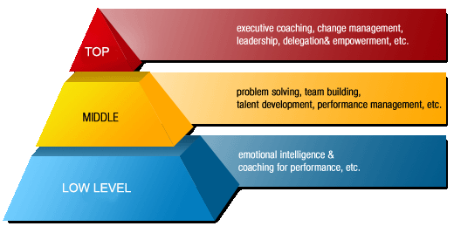
Levels of Planning

Slide 12
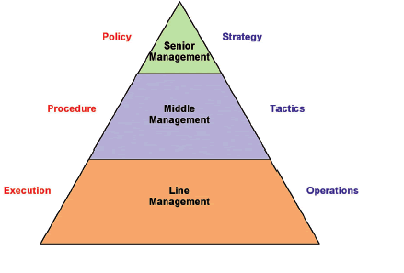
Levels of Planning

Slide 13
Steps in Planning
I. Strategic Plan
A strategic plan is a high-level overview of the entire business, its vision, objectives, and value.
The crucial components of a strategic plan are:
1. Vision
Get a bird’s eye view of management
2. Mission
The mission statement is a more realistic overview of the company’s aim and ambitions.
3. Values
“Inspire. Go above & beyond. Innovate. Exude passion. Stay humble. Make it fun”

Slide 14
Steps in Planning
II. Tactical Plan
The tactical plan describes the tactics the organization plans to use to achieve the ambitions outlined in the strategic plan
1. Specific Goals with Fixed Deadlines
2. Budgets
3. Resources
4. Marketing, Funding, etc.

Slide 15
Steps in Planning
III. Operational Plan
The operational plan describes the day to day running of the company
1. Single Use Plans
These plans are created for events/activities with a single occurrence.
2. On-going Plans
Policy: A policy is a general document that dictates how managers should approach a problem.
Rule: Rules are specific regulations according to which an organization functions.
Procedure: A procedure describes a step-by-step process to accomplish a particular objective

